Slide 1
Machine Learning
Internship Project - 1

Slide 2
Malignant Comment Classification

Slide 3
df.describe()
malignant | highly_malignant | rude | threat | abuse | loathe
count | 159571.000000 | 159571.000000 | 159571.000000 | 159571.000000 | 159571.000000 | 159571.000000
mean | 0.095844 | 0.009996 | 0.052948 | 0.002996 | 0.049364 | 0.008805
std | 0.294379 | 0.099477 | 0.223931 | 0.054650 | 0.216627 | 0.093420
min | 0.000000 | 0.000000 | 0.000000 | 0.000000 | 0.000000 | 0.000000
25% | 0.000000 | 0.000000 | 0.000000 | 0.000000 | 0.000000 | 0.000000
50% | 0.000000 | 0.000000 | 0.000000 | 0.000000 | 0.000000 | 0.000000
75% | 0.000000 | 0.000000 | 0.000000 | 0.000000 | 0.000000 | 0.000000
max | 1.000000 | 1.000000 | 1.000000 | 1.000000 | 1.000000 | 1.000000

Slide 4
df.info()
<class 'pandas.core.frame.DataFrame'>
RangeIndex: 159571 entries, 0 to 159570
Data columns (total 8 columns):
# Column Non-Null Count Dtype
--- ------ -------------- -----
0 id 159571 non-null object
1 comment_text 159571 non-null object
2 malignant 159571 non-null int64
3 highly_malignant 159571 non-null int64
4 rude 159571 non-null int64
5 threat 159571 non-null int64
6 abuse 159571 non-null int64
7 loathe 159571 non-null int64
dtypes: int64(6), object(2)
memory usage: 9.7+ MB

Slide 5
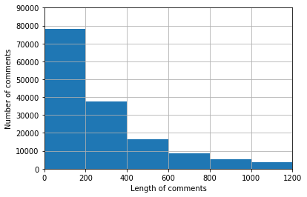
No of comments having lengths varying from 0 to 1200

Slide 6
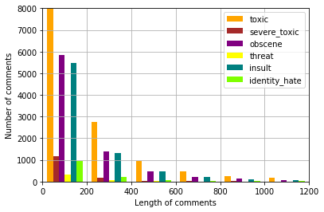
Number of comments classified

Slide 7
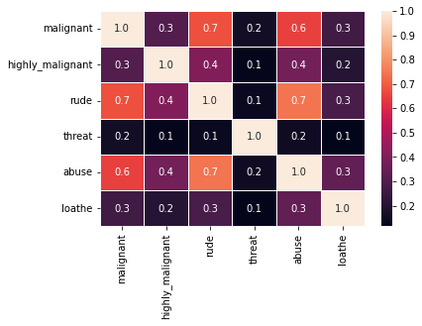
Correlation

